Slide 1
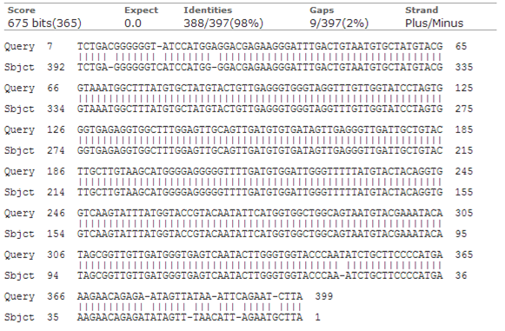
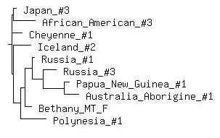
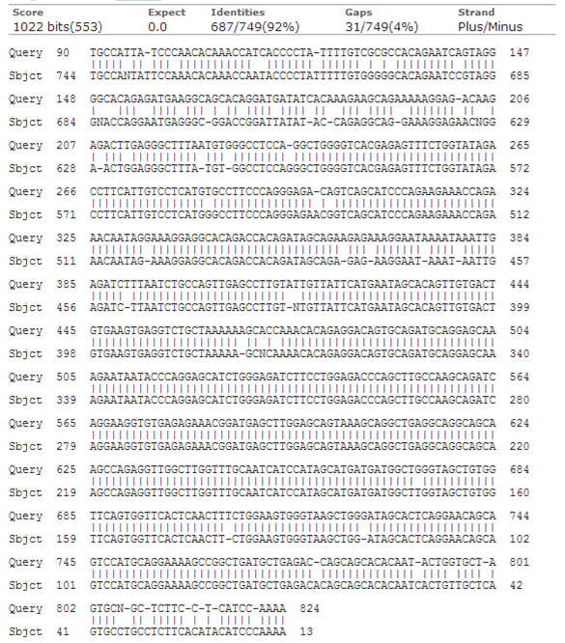
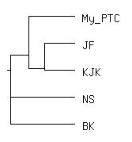
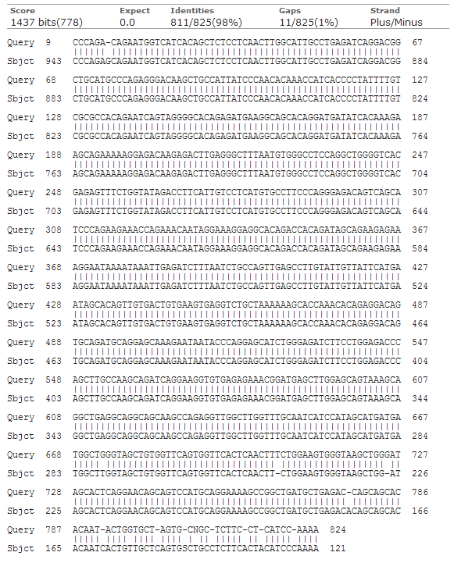
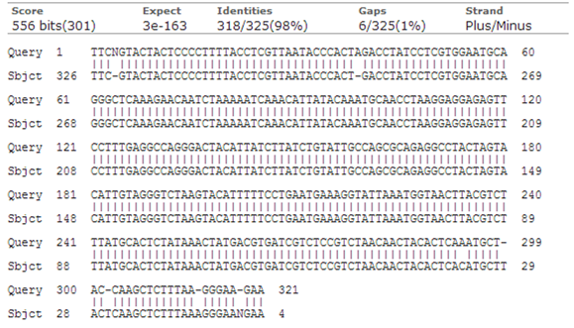
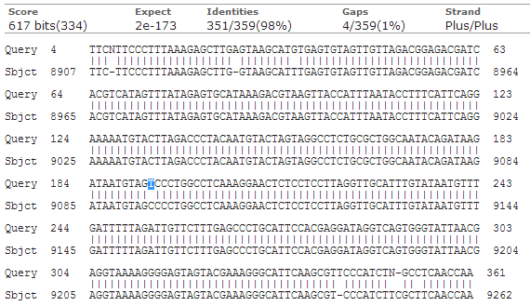
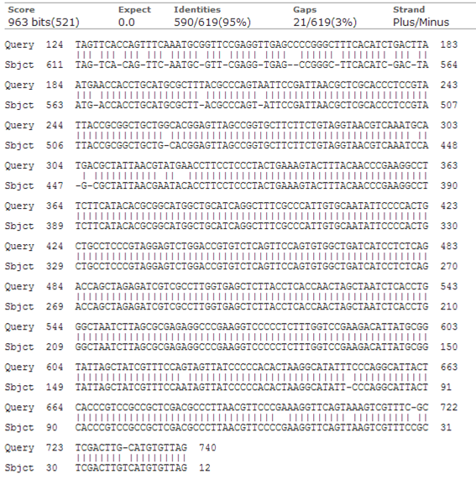
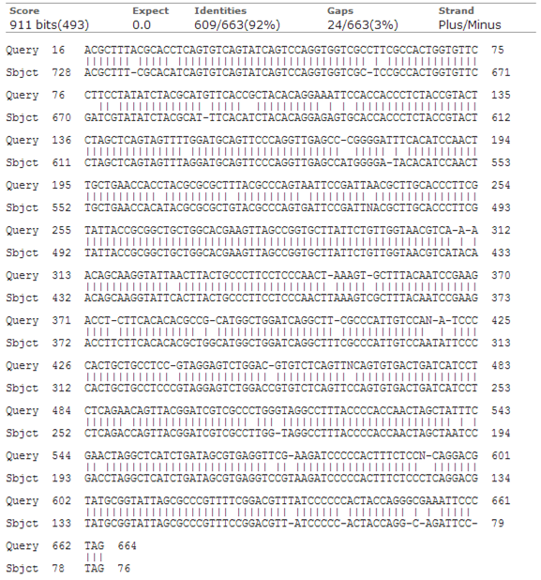
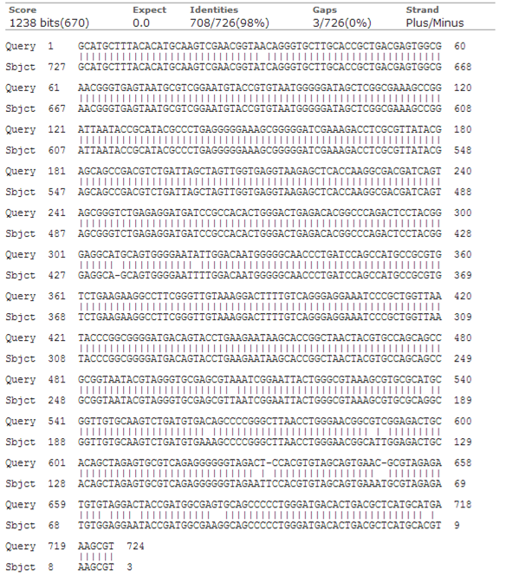
DNA, DNA, DNA, DNA
A study of PTC tasters, Lactose Intolerance, Mitochondrial DNA, and Bacteria
Melissa N. Moyer and Dr. K. J. Karnas
Cedar Crest College 100 College Drive, Allentown PA 18104
Background
Mitochondrial
Mitochondrial DNA is a cell’s “second” genome. The mitochondrial DNA is so abundant in human cells that it is actually considered the easiest human DNA to amplify via PCR. It once existed as an free-living bacteria before it was taken up by an ancestor to eukaryotic cells, where the genome has been reduced to approximately 16569 nucleotides that code for 37 genes.
In humans, these mitochondria are inherited from the mothers, allowing for the tracing of maternal lineage. We did this by amplifying a small section of the mitochondrial chromosome and then compared that sequence to known sequences via bioservers.
PTC Tasters
In nature, a bitter taste usually meant that what was being eaten was poisonous. PTC, or phenylthiocarbamide is a bitter compound used to test if someone can taste bitter or not. The gene associated with the ability (or lac there of) to taste PTC is known as TAS2R38.
To test if you can taste PTC or not, they have PTC coated papers that you can place in your mouth. Then, record if it is a strong taste, a weak taste, or if you don’t taste anything at all.
Lactose Tolerance
Lactase is the enzyme that allows Lactose to be broken down. The presence of Lactase is associated with Lactose tolerance, while the absence of Lactase makes someone Lactose intolerant. Lactose tolerance is thought to evolved over time, allowing people who can digest lactose to survive better. Now, the presence of milk and milk products is very prevalent because of how many people are able to continue to digest Lactose as they age.
Bacteria
It is well known that there is a greater number of bacteria both in and on you than there are cells in your body. We took swabbings of different parts of our bodies to see what bacteria we were growing. Some of the most swabbed areas were mouths, hands and belly buttons. I chose to sequence cultures that I have been working with to make sure we have the correct bacteria.
Results
Conclusions
Mitochondria
Despite my own mitochondrial DNA not producing results, Bethany’s Mitochondrial DNA revealed that she was closely related to a modern Russian and Modern Polynesian through her maternal heritage. Meaning that it had to be a female from her mother’s side that was Russian or Polynesian. This information seemed to come as a pleasant surprise for my lab partner Bethany.
PTC Taster
Out of the seven participating subjects, only five received a PTC sequence amplification. Of these five, three were mild tasters and there was one non-taster as well as one strong taster. The phenogram in Figure 4 done with sequence alignments confirmed these findings.
Lactose Tolerance
Bethany’s Lactase gene lined up nearly perfectly, and according to her DNA she is able to digest lactose. When questioned, her diet seems to also confirm her ability to digest lactose.
Bacteria
The three bacteria that were sequenced were from the Molecular Genetics lab, where the students were trying to insert a gene of interest from one organism into E. coli. I chose to sequence these organisms in order to confrim that these were the correct organisms that were being used. According to the sequencing data, the organisms are genetically similar to their species DNA sequence listed on the NCBI website.
Mitochondrial
Despite trying several different mitochondrial DNA (mt DNA) dilutions, I was unable to isolate and amplify my own mitochondrial DNA, so I chose to analyze my classmate Bethany’s mt DNA. Figure 1, on the left, shows the forward and revers alignment of Bethany’s mt DNA. There was a 98% identity, with 2% gaps across approximately 400 nucleotides. Figure 2, to the right, shows a phenogram including Bethany’s mt DNA as well as several other Human sequences. It appears that Bethany is Most closely related to Russian number 1 and Polynesian number 1.
Figure 1: Bethany’s mt DNA forward and reverse sequence aligned.
Figure 2: A phenogram including Bethany’s mt DNA compared to other modern human DNA added to bioservers in 2000.
PTC Taster
In the class, there was a good distribution of tasters and non-tasters. Personally, I was a medium taster, along with several of my classmates. There was one strong taster, and one non-taster. Of the seven participating subjects, only five of the participants actually had a sequence for PTC, seen in Figure 4 to the right. To the left, Figure 3, is the forward and reverse
Figure 4: Class relationships in the ability to taste PTC.
alignment for my TAS2R38 gene. In Figure 5, to the right, my TAS2R38 sequence is aligned to an isolated bitter taste receptor for humans. I was aligned with a 98% accuracy, using my reverse sequence as my forward sequence was not readable past nucleotide 360 (not shown).
Figure 3: My TAS2R38 gene forward and reverse sequence aligned.
Figure 5: My TAS2R38 gene aligned with Homo sapiens isolate SPWHosa bitter taste receptor TAS2R38 (TAS2R38) gene, complete.
Lactose Tolerance
Despite trying several
different Lactase DNA
dilutions, I was unable to isolate and amplify my own Lactase gene, so I chose to analyze my classmate Bethany’s Lactase gene. Bethany’s Lactase gene seems to be in perfect working order. Note the blue highlighted nucleotide in Figure 7. This is indicative of a working lactase enzyme according to Schultheis and Bowling 2011. Figure 6 is the alignment of Bethany’s Lactase gene with both the forward and reverse primers.
Figure 6: Bethany’s forward and reverse lactase gene aligned.
Figure 7: Bethany’s forward lactase gene aligned with Homo sapiens lactase (LCT), RefSeqGene on chromosome 2.
Bacteria
Three bacteria were sequenced for species confirmation. The Vibrio fischeri in Figure 8 aligned with Vibrio fischeri ES114 at a 97% identity. The Pseudu Argius in Figure 9 aligned at a 95% identity with Pseudomonas aeruginosa PA1R. The Chromobacterium violoccum in Figure 10 aligned with the Chromobacterium violaceum ATCC 12472 strain ATCC 12472 16S ribosomal RNA at a 97% identity. This convirmed that the bacteria that we were studying are the bacteria we wanted.
References
Karnas, K., Automated Sequencing Project #1 Mitochondrial Handout, Fall, 2013.
Karnas, K., Automated Sequencing Project #2 PTC Gene, Fall, 2013.
Karnas, K., Automated Sequencing Project #3 Latcatse Persistence SNP, Fall, 2013.
Karnas, K., Automated Sequencing Project #4 Bacterial Identification by rRNA Sequence, Fall, 2013.
http://blast.ncbi.nlm.nih.gov/Blast.cgi
http://www.bioservers.org/bioserver/
Figure 8: Forward and reverse Vibrio fischer sequence aligned.
Figure 9: Forward and reverse Pseudu Argius sequence aligned.
Alignments to known sequences were done using the experimental forward sequences, unless otherwise stated.
Figure 10: Aligned forward and reverse Chromobacterium violoccum sequence.
Background Picture from: http://esciencecommons.blogspot.com/2011/01/undersea-cables-add-twist-to-dna-study.html

